Slide 1
X-Men: The Last Stand
John McKay, Nathan Donaldson, Clint Wilkinson, Keith Madsen

Slide 2
Overview
Intro and ALU Design - (John McKay)
Register Design and Integration with ALU - (Nathan Donaldson)
Memory Access Interface - (Clint Wilkinson)
Mechanical Crane Application - (Keith Madsen)

Slide 3
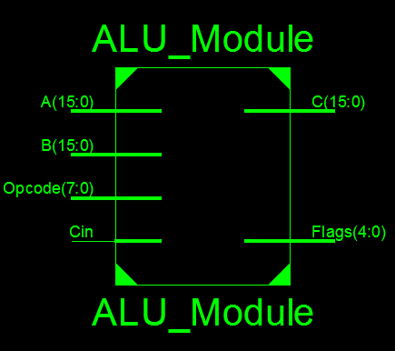
ALU Design
16 bit ALU
CR 16 Instruction Set
Opcode encoding is:
(bits 7-4) opcode
(bits 3-0) Opcode extension or Immediate
This will change with controller

Slide 4
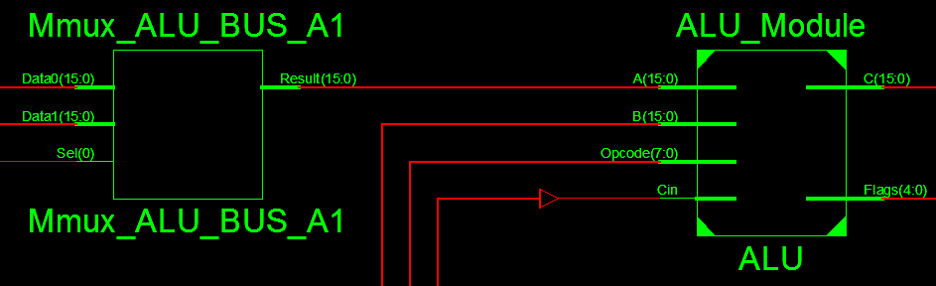
ALU Design
Use mux to put immediates on input A
Flags are stored in a flag register
Cin comes from the flag register

Slide 5
ALU Design
Current Opcode Instructions
Things to add in the future
Adds
Subtracts
Compares
Logical Operators
Shifts
Not
WAIT / NOP
Moves
LOAD
STORE
Jump/Branch
Sign extend immediates
Controller to set the opcode/immediate

Slide 6
ALU Testing
Tested each opcode using corner cases
Exhaustive testing using Random simulator tests
Miter Test
Made a display module for the 7 seg-display
Synthesized tests to the FPGA and displayed results on 7 seg-display

Slide 7
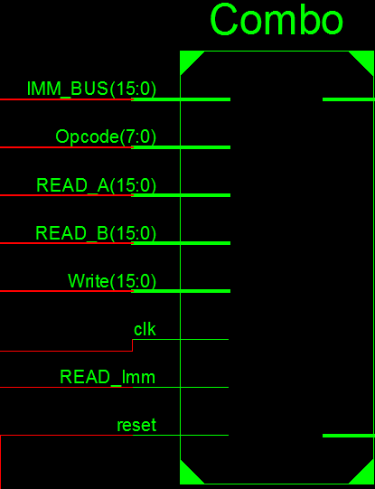
ALU, Register File, Control Signals
Read_A and IMM_BUS sent to MUX
Read_Imm controls said MUX
Write controls enable signal on each register
Clk, reset, READ_B

Slide 8
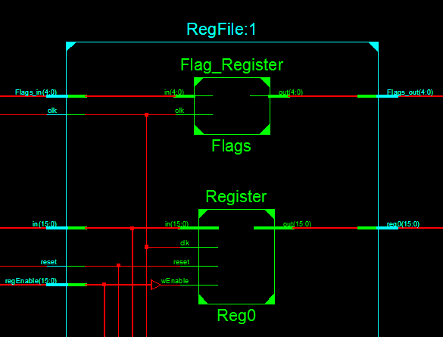
Inputs: Flags(from ALU), clk, ALU Bus input, reset, register enable.
Cin flag loops back to ALU
Other flags will be used later.
R9-R15 Temp
R2-R8 Save
R1 Stack Pointer
R0 Return Address
FP, others?

Slide 9
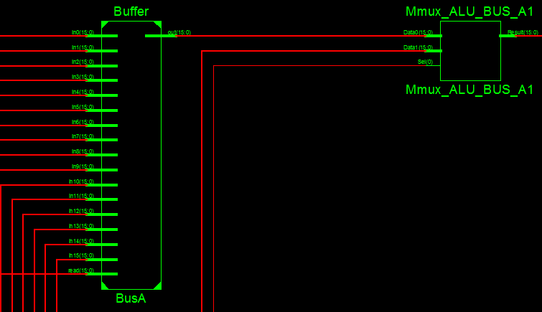
Buffer is filled with tristate buffers.
This buffer is MUXed with an immediate bus.
BusB does not have MUX.

Slide 10
Testing
Fibonacci Sequence
R0 + R1 -> R1 -> R2
R1 + R0 -> R0 -> R3
R0 + R1 -> R1 -> R4
………

Slide 11
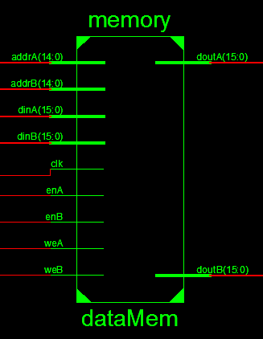
Memory
Characteristics
Dual Port / Write First
32 Blocks / 1024 Words per block
16 bit Words
Divisions
Instructions
Data
VGA/Sound

Slide 12
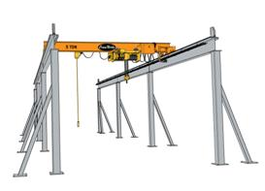
Port Assignments
Port A
Processor use only
Port B
VGA
Sound
Limit Switchs

Slide 13
Memory Testing
Individual Reads and Writes
Simultaneous Reads and Writes with both ports.
Simultaneous Reads and Writes using previously written values.

Slide 14
Problems
Read First vs. Write First
Enable Pulse vs. Direct Clock Divider

Slide 15
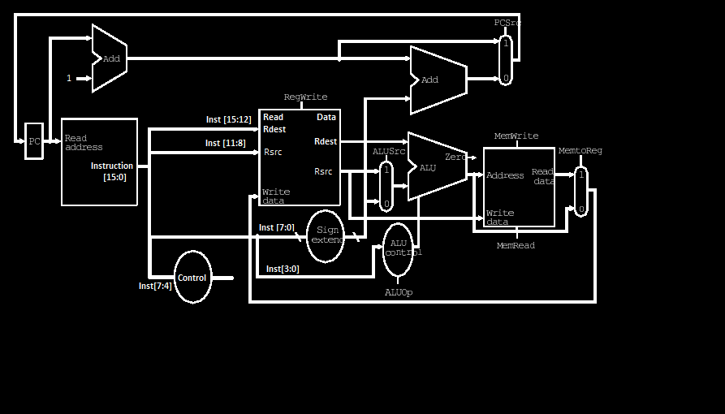

Slide 16


Mechanical Crane A.K.A The Fishing Game
N
Limit Switch
Motorized Game
Compass Movements
Z Axis Not Shown
Limit Switches
NES/SNES Controlled
Pick Up Items or Fish
W
E
Limit Switch
S

Slide 17
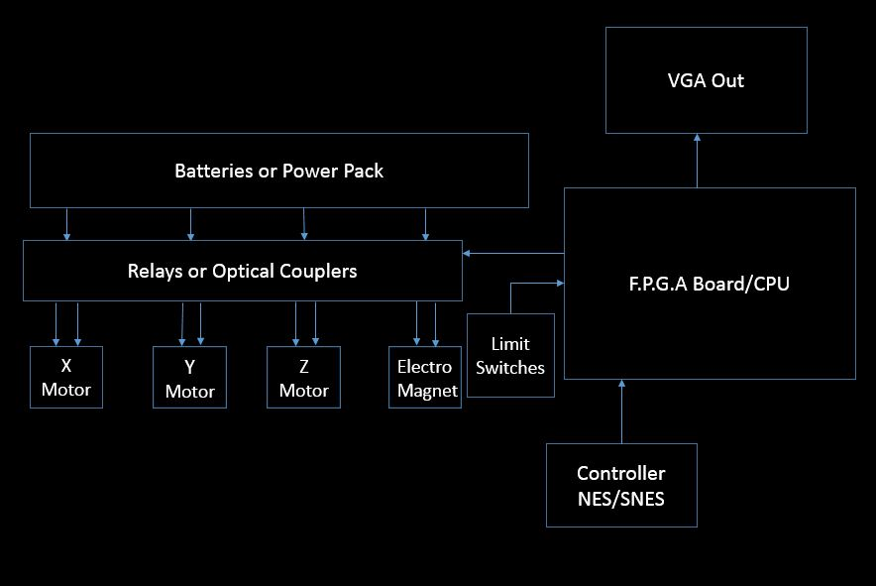

Slide 18
Future Considerations
Motorized Turntable with Variable Speed
Electro Magnet
Sound
Auto Scoring Bin
Cost

Slide 19
Summary
ALU Discussion
Register File and ALU Combination
Memory
Project Direction

Slide 20
Questions?

